Slide 1
AI Doesn't Bite
How To Get Over Your Initial Hurdles
A practical guide from zero to AI-powered workflows

Slide 2
But first…
Why Are People Still Avoiding AI?
The data says adoption is stalling — and networking is further behind than most
Negative Hype Cycle
Overpromise, underdeliver, disillusionment
Security
Data exposure, model vulnerabilities, governance gaps
Cost
Unclear ROI, high infrastructure spend, hard to justify
Privacy
Confidential data leakage, compliance concerns

Slide 3
The AI Hype Cycle Has Peaked
Gartner 2025: Gen AI has entered the “Trough of Disillusionment”
74%
struggle to achieve and scale AI value
BCG, 2024
95%
of enterprise Gen AI pilots deliver
zero return on investment
MIT, 2025 — 300 public deployments studied
$1.9M
avg. spent per org on Gen AI, <30% of CEOs satisfied
Gartner, 2025
42%
of businesses scrapped most
of their AI initiatives in 2025
S&P Global, up from 17% in 2024
57%
of organizations say their data is not AI-ready
Gartner, 2025

Slide 4
Top Barriers to AI Adoption
IBM Global AI Adoption Index, 2025 — survey of enterprise leaders
Concerns about data accuracy or bias
45%
Insufficient proprietary data to customize models
42%
Inadequate generative AI expertise
42%
Inadequate financial justification / business case
42%
Concerns about privacy / confidentiality of data
40%

Slide 5
Networking Is Even Further Behind
Network automation lags behind every other area of IT — and AI adoption in NetOps is struggling
Network Automation Forum Survey 2025
681 respondents, 58 countries, 34 industries
Industry Research
18%
of network automation projects fully succeed
EMA / Itential, 2024
55%
of networks are 50% automated or less
67%
of enterprise network activity remains manual
Gartner, 2025
Top barriers to more automation:
Skills challenges
Organizational challenges
Technology challenges
Cultural resistance
81% want to automate more but can’t
35%
report complete success with AI-driven NetOps
EMA, Jan 2026
27%
of network teams report day-to-day succes
EMA, down from ~50%

Slide 6
The Good News?
Every one of these barriers has a practical workaround — and most of them start with tools you already have.
Hype?
Start with real, small use cases — not the hype
Security?
Local models never phone home — your data stays yours
Cost?
Run models locally for free — zero API cost to learn
Privacy?
Offline, air-gapped AI is real — no cloud required

Slide 7
What We'll Cover Today
01
Getting Started Free & Local
Ollama, LM Studio, Foundry Local
02
Pick a Cloud Provider
OpenAI, Google, Anthropic
03
Get an API Key
Access AI programmatically
04
Incorporate AI Into Scripts
Practical integration patterns
05
RAG
Retrieval-Augmented Generation
06
MCP
Model Context Protocol
07
AI Agents
Autonomous AI workflows

Slide 8
Getting Started
Free, Local, Private, Offline

Slide 9
Why Start Local?
Free
Zero cost to experiment.
No API bills. No subscriptions.
Just download and go.
Private
Your data stays on YOUR machine. Nothing leaves.
Perfect for sensitive work.
Offline
Works without internet.
Airplane mode? No problem.
Full AI on the go.
Fast
No network latency.
Instant responses from your local hardware.

Slide 10

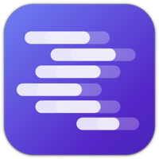




The Local AI Toolkit
CLI-first, developer focused
162K+ GitHub stars
Docker-like simplicity:
ollama run llama3
Beautiful desktop GUI
Discover & test models visually
Great for beginners
Side-by-side comparison
Microsoft's local runtime
Integrates with Windows
Optimized for NPU chips
Familiar MS ecosystem

Slide 11
What GPU Do You Need?
Spoiler: not much. I started on an old GTX 2060.
Model Size
VRAM Needed
Example GPUs
What You Can Run
7-8B params
4-6 GB
GTX 1660, RTX 2060
Llama 3 8B, Mistral 7B
13B params
8-10 GB
RTX 3060 12GB
CodeLlama 13B, Llama 2 13B
32-34B params
16-20 GB
RTX 4060 Ti 16GB
DeepSeek 33B, Mixtral
70B params
35-40 GB
RTX 4090 24GB (quantized)
Llama 3 70B Q4
Formula: VRAM (GB) ≈ Parameters (B) × 0.5 for Q4 quantization
No GPU? Many 7B models can run on CPU-only (just slower)

Slide 12
Up & Running
Install Ollama
Download from ollama.com
One installer, all platforms (Mac, Windows, Linux)
3 Steps
Pull a Model
ollama pull llama3.1
Choose from 100s of models. Models download once.
Start Chatting
ollama run llama3.1
Or use the REST APIhttp://localhost:11434

Slide 13
Pick a Cloud Provider
When You Need More Power

Slide 14

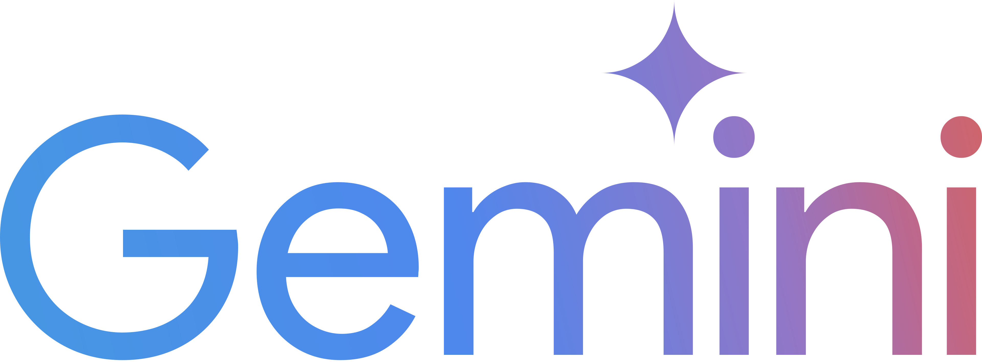
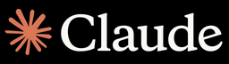
The Big Three
Open AI
Google
Anthropic
GPT-5.5
Gemini 3.1
Opus 4.7 / Sonnet 4.6
900M weekly users
Best all-rounder
Largest plugin ecosystem
Strong coding & creativity
750M monthly users
1M token context window
Deep Google integration
Multimodal from the start
Precision & safety focus
Best coding benchmarks
Lowest hallucination rate
Extended thinking mode

Slide 15
Pricing at a Glance
OpenAI
Google
Anthropic
Free Tier
✓ GPT-4o (limited)
✓ Gemini (generous)
✓ Sonnet 4.6 (limited)
Paid Plan
$20/mo (Plus)
$19.99/mo (Advanced)
$20/mo (Pro)
Pro/Max
$200/mo (Pro)
—
$100/mo (Max)
API: Budget
$0.15/M (GPT-4o mini)
$0.075/M (Flash)
$3/M (Sonnet)
API: Frontier
$10/M (o3)
$1.25/M (2.5 Pro)
$15/M (Opus)
All three have surprisingly capable free tiers — start there!

Slide 16
Get an API Key
Create an Account
Sign up at the provider's developer portal
platform.openai.com | aistudio.google.com | console.anthropic.com
Generate Your Key
Navigate to API Keys section | Click 'Create new secret key'
Copy it immediately (shown only once!)
Store It Safely
Never hardcode keys in your source code
Use environment variables or a .env file | Add .env to your .gitignore
Set a Budget
All providers let you set spending limits
Start with $5-10/month to experiment | Monitor usage through the dashboard

Slide 17
Incorporate AI Into Your Scripts
From Chat to Code

Slide 18
The Key Insight
Local
curl http://localhost:11434/api/chat
-d '{"model": "llama3.1",
"messages": [{
"role": "user",
"content": "Hello!"}]}'
Every AI provider speaks HTTP.
If you can make a POST request, you can use AI.
Cloud
curl https://api.openai.com/v1/chat
-H "Authorization: Bearer $KEY"
-d '{"model": "gpt-4o",
"messages": [{
"role": "user",
"content": "Hello!"}]}'

Slide 19
Integration Patterns
Shell Scripts
Pipe output through AI for summarization, parsing, or data extraction
REST APIs
Any language with HTTP can call AI — Go, Rust, C#, Java, Ruby...
Python / JS SDKs
Official libraries handle auth, retries, and streaming for you automatically
No-Code Tools
Zapier, Make, Power Automate all have AI integrations built right in

Slide 20
rag
Retrieval-Augmented Generation

Slide 21
What Is RAG?
The Problem
LLMs only know training data
No access to your company docs
Knowledge is frozen at cutoff date
Can hallucinate when unsure
Give AI access to YOUR data at query time — without retraining the model.
The RAG Solution
Retrieve relevant docs first
Inject context into the prompt
AI answers grounded in your data
Always up-to-date, verifiable

Slide 22
How RAG Works
Your Question
Knowledge Sources
Search Knowledge Base
PDFs & Docs
Databases
Wikis & Confluence
Code Repos
Emails & Tickets
LLM & Context
Grounded Answer

Slide 23
MCP
Model Context Protocol

Slide 24
What Is MCP?
"USB-C for AI" — one universal connector between AI and your tools.
Before MCP
With MCP
10 AI apps × 100 tools =
10 clients + 100 servers =
1,000 custom integrations
110 implementations
Every combination needs its own connector. Fragile, expensive, nightmare to maintain.
Each app implements MCP once. Each tool implements MCP once. Everything just works together.

Slide 25
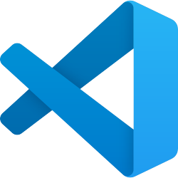

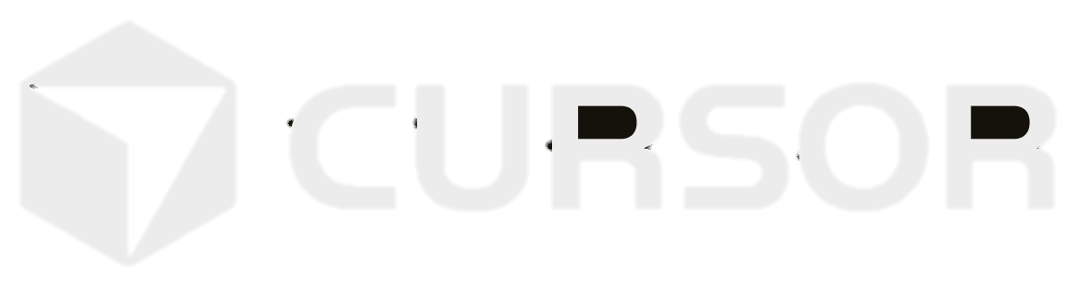
MCP By the Numbers
Adopted by the Entire Industry
15,000+
Public MCP Servers
VS Code
300+
MCP Clients
97M+
Monthly SDK Downloads
Released by Anthropic (Nov 2024) • Donated to Linux Foundation (Dec 2025) • Vendor-neutral open standard

Slide 26
MCP in the Real World: Network Automation
56 production-ready MCP servers now span every layer of the network stack — making “VibeOps” a reality today.
MCP Server Categories
Key Takeaways
Device & Platform Automation (Cisco, Arista, Juniper)
Source of Truth & ITSM (NetBox, ServiceNow)
Cloud Infrastructure (AWS, Azure, GCP, Terraform)
Observability & Monitoring (Grafana, Datadog, Prometheus)
Security & Compliance
Incident Management (PagerDuty, Opsgenie)
Developer & GitOps Workflows
Diagramming, Visualization & Packet Analysis
MCP is the connective tissue of AI-native operations
“VibeOps” — natural language driven operations — is working today, not future concept
Network automation market projected to reach $12.38B by 2030 (18%+ CAGR)
Governance built in: read-only defaults, explicit write flags, Git-based audit trails
AI agents can now query CMDBs, push configs, and check cloud spend via natural language
The automation gap was never about technology — it was a translation gap that MCP bridges
Source: Itential — The Ultimate MCP Guide: 56 Essential MCP Servers for AI-Driven Network Automation

Slide 27
AI Agents
AI That Takes Action

Slide 28
What Are AI Agents?
LLMs that can use tools, call APIs, and complete tasks independently.
Chatbot
You ask, it answers
Assistant
Uses tools when asked
Agent
Plans & acts autonomously
2022-2023
2024
2025-2026

Slide 29
The Modern AI Stack
How it all fits together
AI Agents (Autonomous Workflows)
MCP (Universal Tool Connection)
RAG (Your Data + Vector Search)
Cloud APIs (OpenAI / Google / Anthropic)
Local Models (Ollama / LM Studio)
Each layer builds on the ones below. Start at the bottom and work up.

Slide 30
Your Learning Path
Week 1
Week 2
Week 3
Week 3
Install Ollama
Chat with a local model
Try different models
Pick a cloud provider
Get an API key
Make your first API call
Add AI to a script
Automate a real task
Experiment with prompts
Explore RAG & MCP
Build an agent workflow
Share what you learned!

Slide 31
AI Doesn't Bite.
Questions?
Start local. Experiment freely. Build something cool.
Get Started Today
→ ollama.com
→ platform.openai.com
→ lmstudio.ai
→ console.anthropic.com

Slide 32
Join the

Slide 33
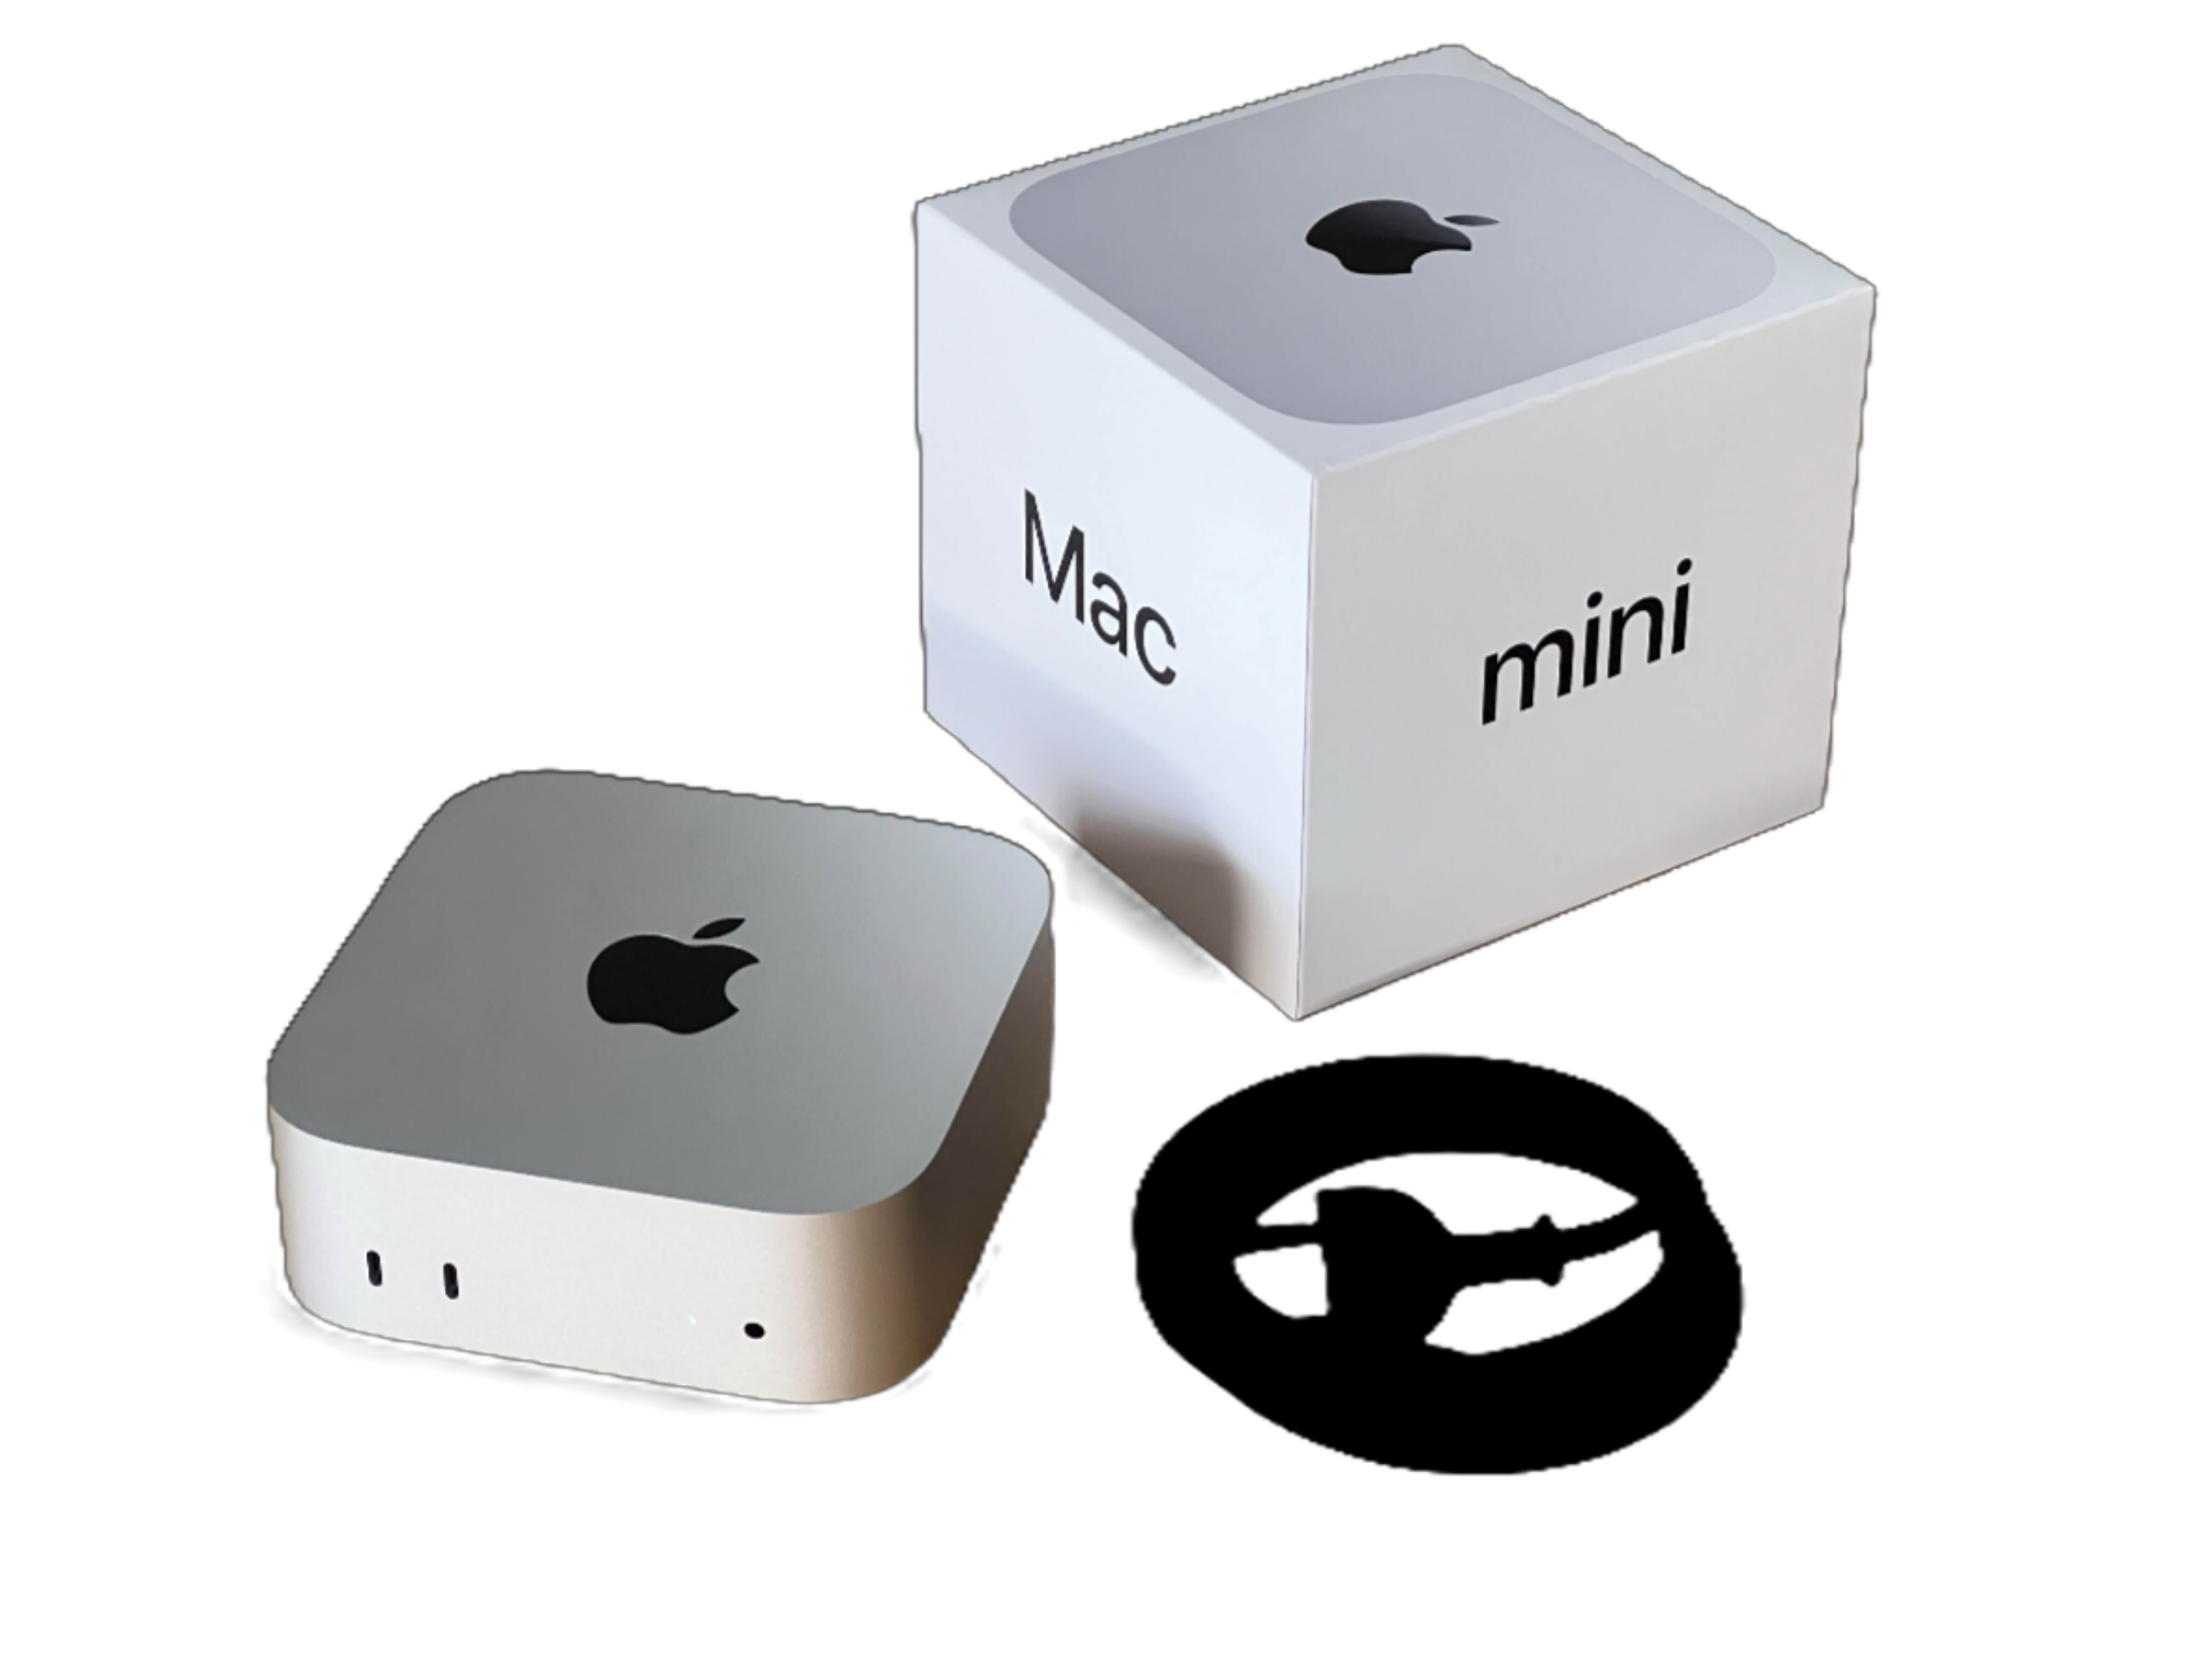
Enter to Win! Mac Mini + 1 Month Claude Max
Scan your badge at the Itential Booth or VibeOps Lounge
Must be present to win
Wed // 06.03 @ 4PM

Slide 34
All the presentations from the VibeOps Lounge are available on GitHub.
github.com/automateyournetwork/CiscoLive2026_VibeOpsLounge

